Slide 1
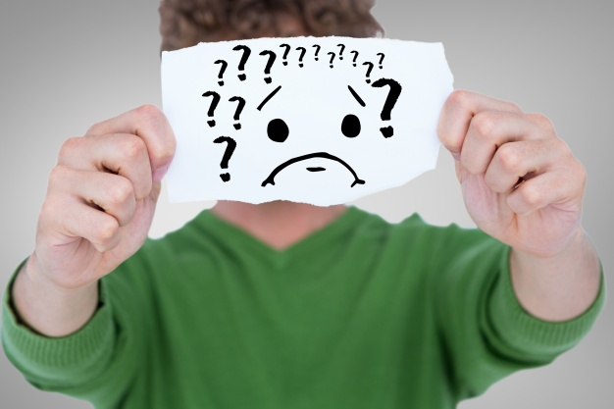
If Grandma is Sick and not Waking Up

Slide 2
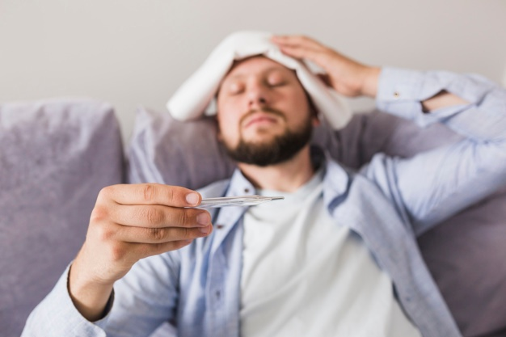
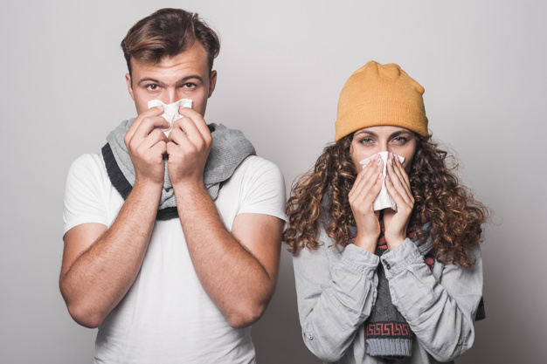
COVID-19, or Corona virus, is like the flu. It makes people get a fever, cough, and be very tired.

Slide 3
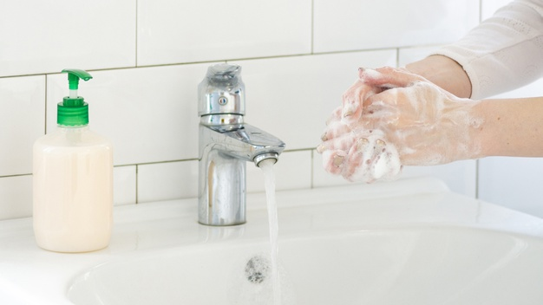
My family is doing everything they can to make us safe. We are staying at home and washing our hands. We are not inviting friends over.

Slide 4
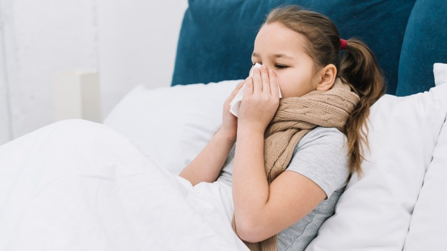
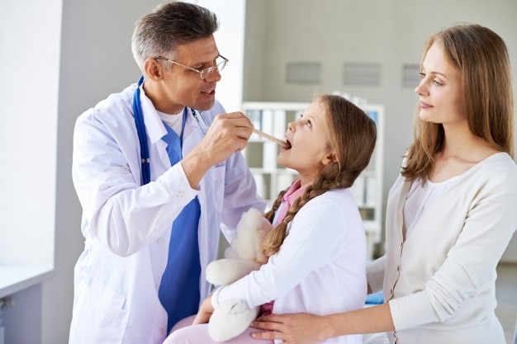
If I get sick, my grandma will take care of me. She may have me take medicine. If I get really sick, she may take me to a doctor to help me get better.

Slide 5
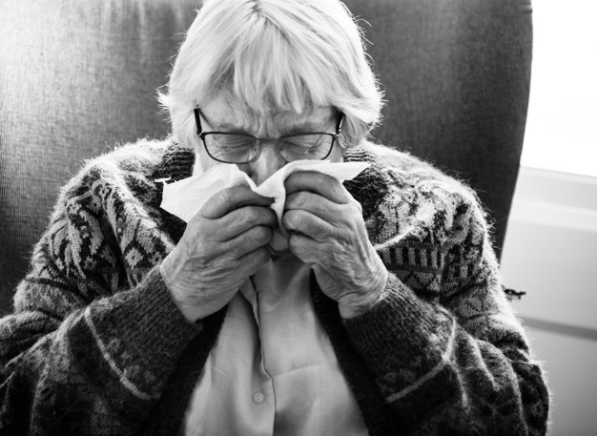
If grandma gets sick, I need to make sure to listen to her. She may need my help to get things from the bathroom or kitchen. I can help grandma, and that will make her happy.

Slide 6
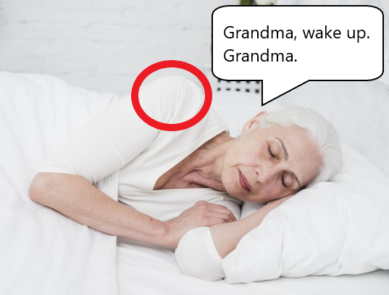
If grandma is sleeping and I need something, I should wake her up. I should start trying to wake grandma up by saying her name and tapping her on the shoulder.

Slide 7
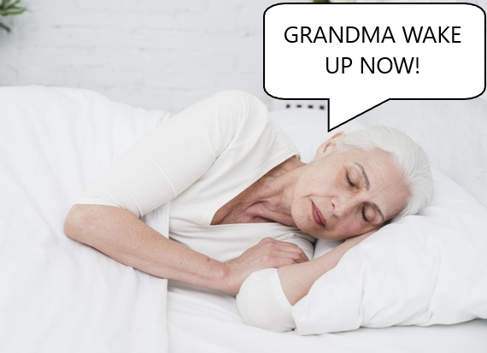
If grandma does not wake up when I say her name and tap her on the shoulder, I should yell her name. It is ok to yell because grandma may be very tired and not able to wake up.

Slide 8
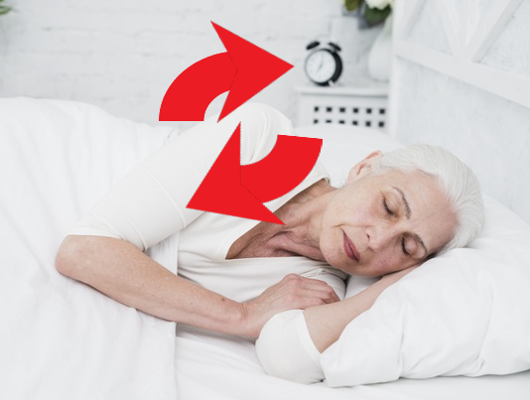
If grandma does not wake up when I yell her name, I should grab her shoulder and shake it. It is ok to do this because grandma is not waking up.

Slide 9
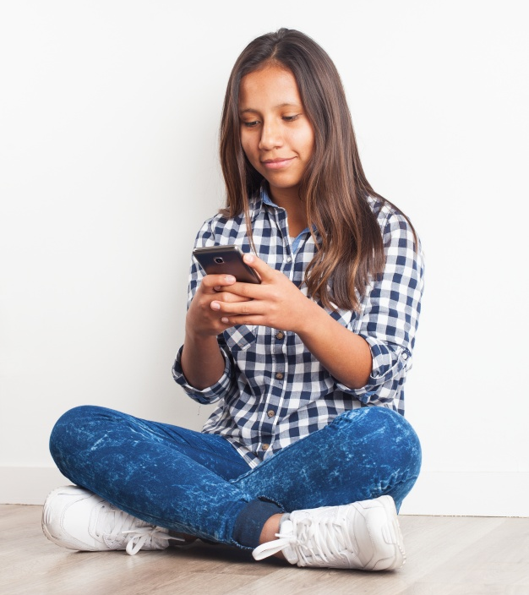
If grandma does not wake up, that means it is an emergency. I need to call 911.

Slide 10
When I call 911, a person will answer the phone. They will say something like “911, what is your emergency?”

Slide 11
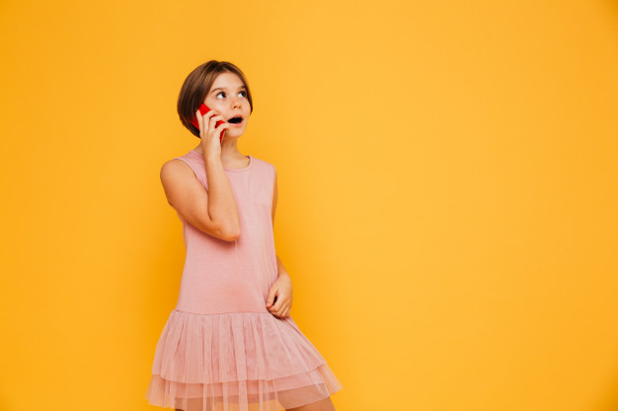
I should tell them my name, where I live, and that my grandma will not wake up and needs help. I can read from my If I call 911 sheet.

Slide 12
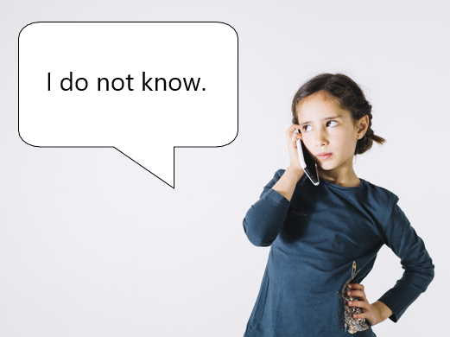
The person may ask me some other questions. I should answer as many of them as I can. If I don’t know an answer, that is ok. I should not get upset. If I do not know an answer I will say “I do not know.”

Slide 13
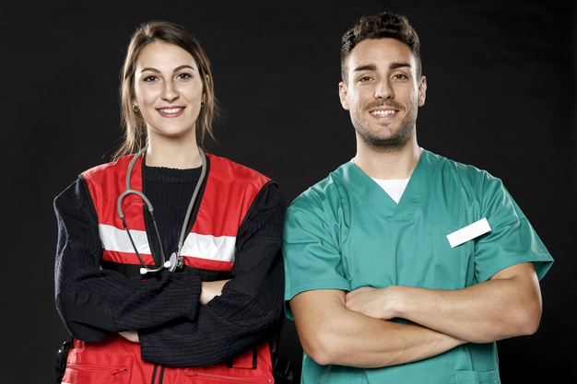
When the helpers arrive, they may ring the doorbell or knock on the door. I should ask who it is. They will say that they are here to help, or that they are paramedics or EMTs. I should open the door to let them in. I should then show them where grandma is.

Slide 14
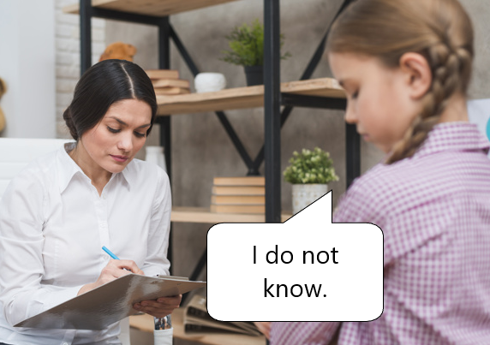
I should give the helpers space to work. I should not try to hug or touch grandma while they are helping her. The helpers may ask me questions. I should answer as many of them as I can. If I don’t know an answer, that is ok. I should not get upset. If I do not know an answer I will say “I do not know.”

Slide 15
The helper may ask me if I have anyone to stay with. If they ask this I should show them My Emergency Information sheet. They can call the people grandma wrote down and let them know what is going on.

Slide 16
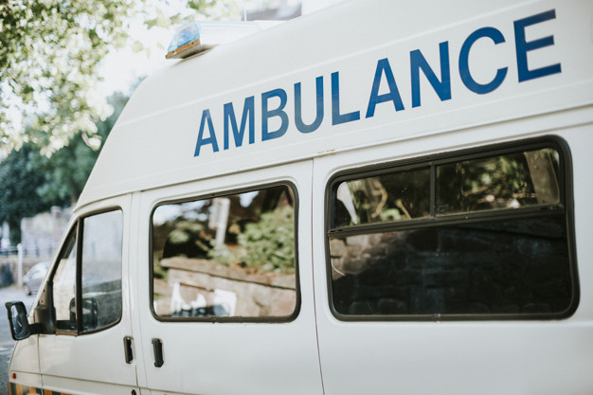
The helpers will need to take grandma to a doctor. I may need to go with them. I should bring my Emergency bag and My Emergency Information sheet. If I need to go with them, I should be very calm. This will make the workers be able to take care of grandma. I am being very brave.

Slide 17
The helpers will need to take grandma to a doctor. I may need to go to someone else’s house. I should bring my Emergency bag and My Emergency Information sheet. If I need to go to someone else’s house, I should be very calm. This will make the workers be able to take care of grandma. I am being very brave.

Slide 18
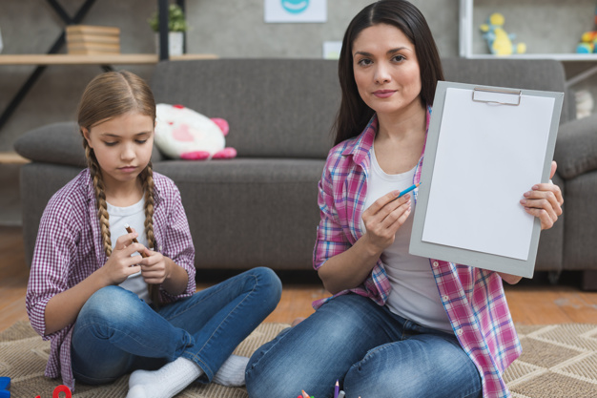
The helpers will need to take grandma to a doctor. I may need to stay home. If I need to stay home, I should be very calm. This will make the workers be able to take care of grandma. When another adult arrives, I should show them My Emergency Information sheet. I am being very brave.

Slide 19
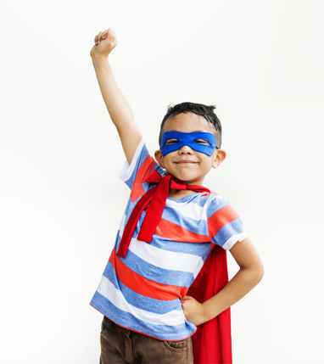
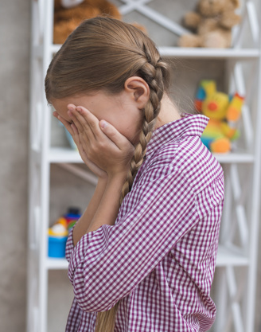
Grandma being sick is scary. I may feel sad. It is ok to be sad. I should remember that grandma would be very proud of me for being brave and getting her help.

